Slide 1
Mutually Exclusive Collectively Exhaustive

Slide 2
What is MECE?
(Mutually Exclusive Collectively Exhaustive)
A framework for solving complex business problems – describes a way of organizing information that is
“Mutually Exclusive, Collectively Exhaustive”

Slide 3
The MECE principle suggests that to fix any large problem…
Mutually Exclusive
Items that can fit into one category
you need to understand your options by sorting
them into categories that are:
Collectively Exhaustive
All items can fit into one of the categories

Slide 4
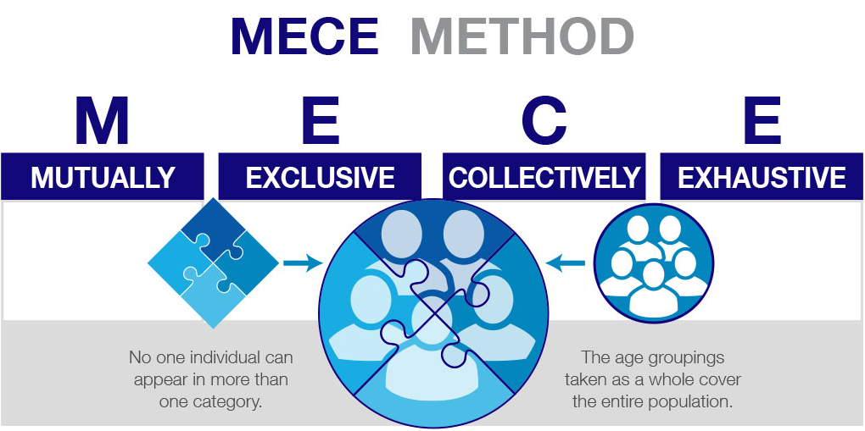

Slide 5
In “plain English” a MECE set is one that has no overlaps and no gaps

Slide 6
MECE Example: Age Brackets
You may have a customer list segmented according to these age brackets:
Age 0-15
Age 16-30
Age 31-45
Age 46-60
Age 61-75
Age 76+
With these categories you have covered all possible ages of customers
No one can appear in more than one category
Notice about 15 years are represented in each category this makes them easily comparable.

Slide 7
Grouping Customers by their ages is an example of

Slide 8
Examples of MECE Segmentation
Defined age brackets where there is no category overlap
Defined revenue brackets
Country of Birth, assuming no geographical overlap
Number of employee brackets
Highest level of education obtained

Slide 9
Examples of Non-MECE Segmentation
Hobbies and Interests
not MECE because not mutually exclusive can appear in more than one category, and not collectively exhaustive because not all are involved in hobbies or interests
Colleges Graduated From
not MECE because not mutually exclusive can appear in more than one college category ex: undergraduate college a and graduate college b, not collectively exhaustive because not all graduate from college

Slide 11
4 Principles for using MECE

Slide 12
Principle 2 The Sum of Parts Must
Equal the Whole Group
Age 31-45
non-MECE because 45 appears in both 31-45
Age 45-60
non-MECE because 45 appears in both 45-60

Slide 13
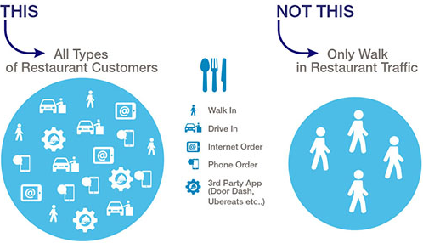
Principle 3 Small Elements Must
Parallel One Another
To be collectively exhaustive the framework must represent the whole group
Example Restaurant Customers: a restaurant may have different customer types such as walk-in and drive-through.
However a restaurant could also have online customers, and customers that use 3rd party apps like Door Dash or Uber Eats
To be collectively exhaustive all customer types must be included

Slide 14
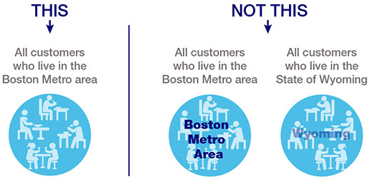
Principle 4 Look Out for Logical
Errors and Inconsistencies
Categories in MECE classification should be directly comparable when possible
Example a business has customers in the Boston Metropolitan area and customers in the entire state of Wyoming.
These two sets of customers are not comparable
You would want to classify instead by all customers in Boston Metro Area only.

Slide 15
Principle 4 – Small Elements Must Parallel One Another
1
MECE is a potent tool but it is not the only too
2
MECE will not protect you from all possible oversights or fallacies
3
Always examine your assumptions closely – even if the MECE framework looks perfect

Slide 16
Using MECE in a Case Interview

Slide 17
Using MECE
in a Case Interview
1
Case Interviews are structured around a hypothetical problem that the interviewer will ask you the case interviewee to solve.
2
MECE will help you to focus on major categories and develop ideas from the top down to assist you and give the interviewer an overview of your solution to the problem.

Slide 18
Example of MECE in a Case Interview
Q
The interviewer asks you the question
“How can XYZ company grow?”
Once you have the information organized
You can narrow down your ideas based on the interviewer’s follow-up questions and information.
A
Here are some possible ways using MECE you can organize your answer.
Option 1: Products/Services – Existing vs. New
Option 2: Customers – Existing vs. New
Option 3: Distribution Channels – Existing vs. New
You may still have overlap in the information but this cannot always be avoided.
Sometimes being MECE-enough is all you can come up with on the spot.

Slide 19
The Profitability Framework

Slide 20
Profitability Framework
A common example of MECE in practice is the profitability framework
Price/Unit
Revenue
Units Sold
Profit
Fixed Cost/Unit
Cost/Unit
Cost
Variable Cost/Unit
# Units Sold
© Victor Cheng, www.caseinterview.com - Free for your personal use, free to distribute freely to others provided content and attribution is left unaltered

Slide 21
Every Step of Profitability Framework is MECE
STEP 1
STEP 2
STEP 3
STEP 4
First, profits are broken down into revenues and costs.
Then, revenues are broken down into volume and price per unit (PPU).
Costs are broken down to fixed costs and variable costs.
Variable costs can be further broken down into volume and cost per unit.

Slide 22
Profitability
Framework
1
MECE allows you to preform multiple analysis while keeping each analysis separate
2
This prevents mistakes caused by incorrectly assuming there is a relationship where there is not one
3
MECE allows you to have full understanding of each individual piece of the problem

Slide 23
For More on the Profitability Framework Go to:
https://www.caseinterview.com/jump/profit-framework

Slide 24
MECE in Everyday Life

Slide 25
One of the best ways to practice your MECE skills is to use it in everyday life
1
Example: Your Spouse asks “Where should we go for dinner tonight?”
2
Break down the question using MECE
Restaurants neither of you have been to
Restaurants one of you have been to
Restaurants both of you have been to

Slide 26
For more Information and
Resources on MECE Go to:
www.caseinterview.com/mece
www.caseinterview.com/mece-frameworks
Case Interview Secrets by Victor Cheng (specifically Chapter 9)
www.caseinterviewsecrets.com

Slide 27
Case Interview Free Resources
www.caseinterview.com

